Slide 1

Wei Dang
Kevin Ellsworth
Cory Shirts

Slide 2

Goal: have a user interface to allow user text input using sign language digits and letters
  User interface
  Development of the algorithm
  Demonstration

Slide 3

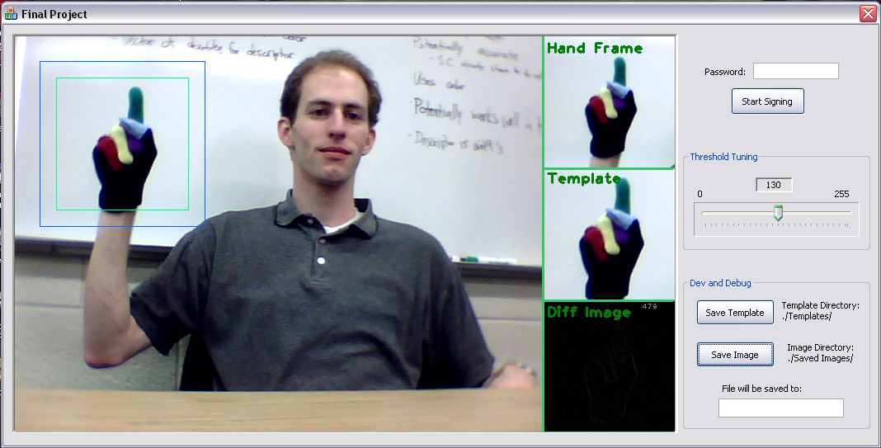
Include screenshot,
Notes:
Explain the screenshot and briefly describe the layout of the GUI

Slide 4

User enters text
Wait for input sign
Thresholding on small ROI
Match templates
Get the best match

Slide 5

Similar signs not distinguishable with b/w template matching
Some min/max values just too close to tell
Digits work fine by themselves
  Most problems introduced when including letters

Slide 6

Shape matching
  Contour based algorithm (B&W)
  No accuracy improvement over threshold template
Template matching with color markers
  Takes longer to process
  Not perfect, but more accurate
Template matching with saturation channels
  Faster, but less accurate than full color

Slide 7

Template matching on color image
Context checking for similar signs
  Some signs are the same for two characters
  Removed some templates for speed up
Distinct hand positions
  Make difference between similar signs more distinct

Slide 8
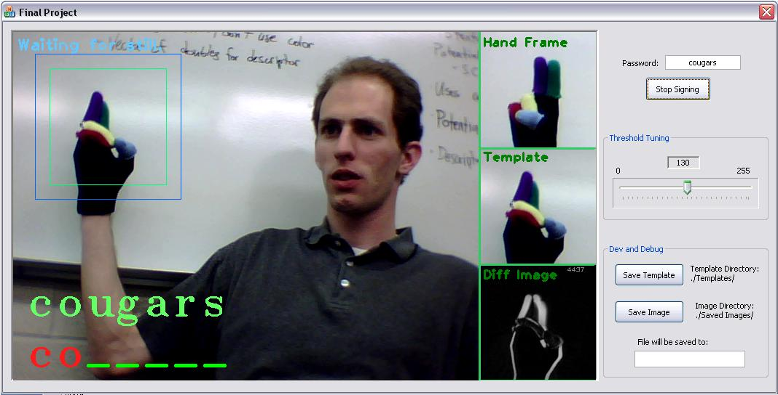
Any questions?

